Slide 1
LOAC (Light Optical Aerosol Counter)
Jean-Baptiste RENARD (LPC2E-CNRS, Orléans, France)

Slide 2
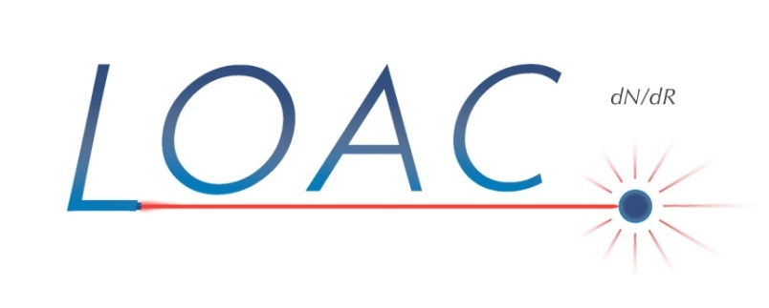
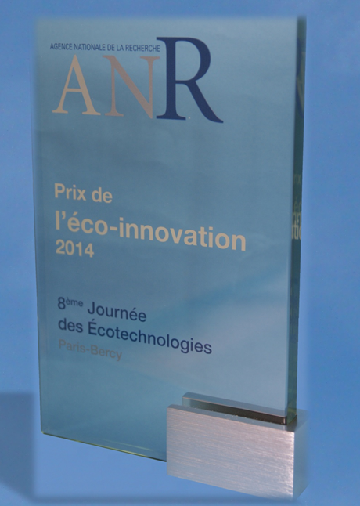
Light Optical Aerosols Counter
Project funded by the “Agence Nationale de la Recherche”
Collaboration between national research laboratory (LPC2E, LSCE/CEA, LA), private companies (Environnement-SA, Aerophile SAS, MeteoModem), and the French Space Agency
90 copies produced at the end of 2014
50 scientific flights under different kinds of balloons

Slide 3
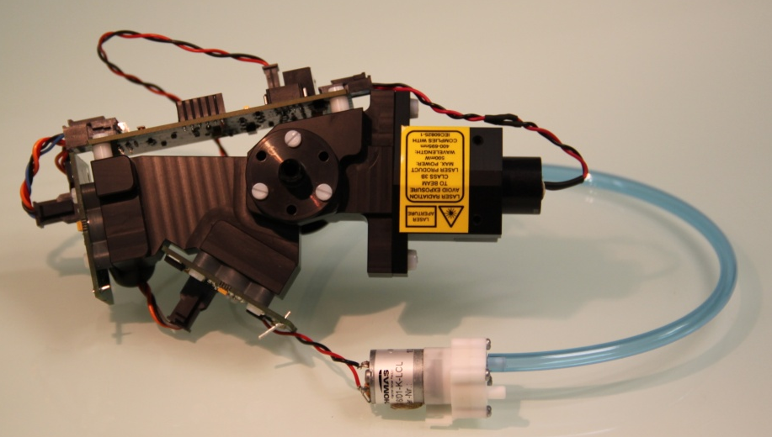
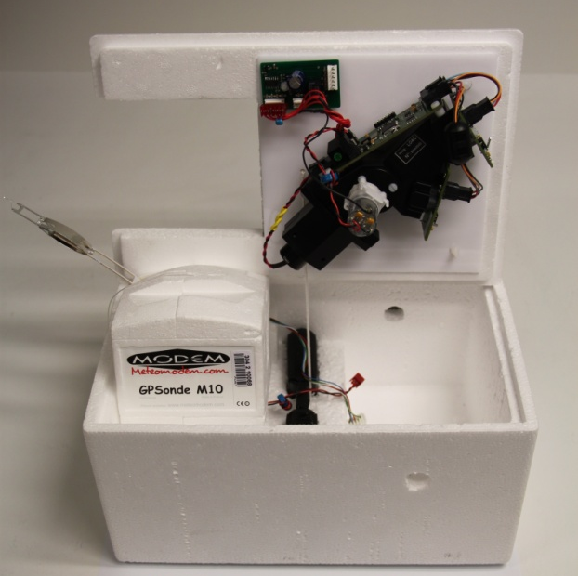
Instrument and pump: 350 g
Electric consumption: ~3 W
No lenses => no risk of misalignment
Concentrations for 19 size classes
between 0.2 and 100 μm
Automatic check every 10 minutes and electronic recalibration if necessary (ex. strong changes in temperature)
Total weigh (gondola, batteries and LOAC): 1 kg for use with meteo balloons

Slide 4
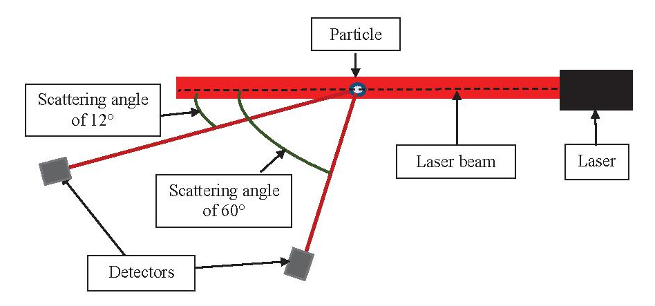
Principle of measurements
2 scattering angles measurements (field of view of few degrees)
~12°, insensitive to the refractive index of the particles (mainly diffraction)
=> accurate size determination and counting
~60°, strongly sensitive to the refractive index of the particles
=> indication of the nature of the particles
Detection of the maximum of intensity for particle that crosses the laser beam
Real-time stray light correction

Slide 5
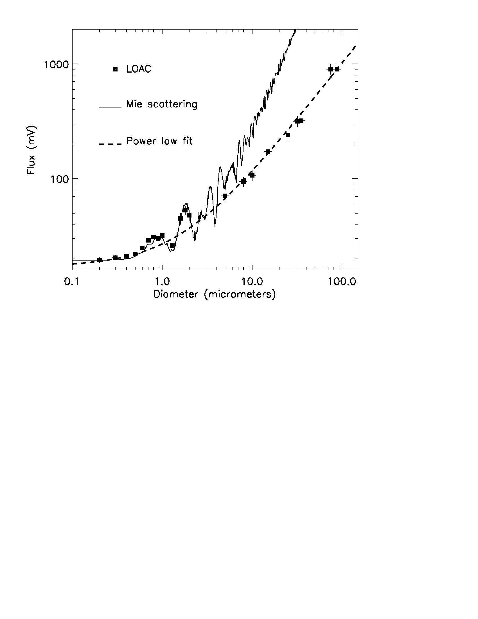
Calibrated with beads and real irregular particles
Similar statistical approach for the detection of irregular particles (all natural solid particles are irregular)
At a given diameter, same scattered flux for different natures of particles (at small scattering angles)
LOAC can be used for liquid and irregular particles but not for perfect solid spheres

Slide 6
Small field of view (few degrees) at small scattering angles
=> large irregular particles are less luminous than expected
Confirmation by modelling (Mie) calculations including a roughness surface coefficient

Slide 7
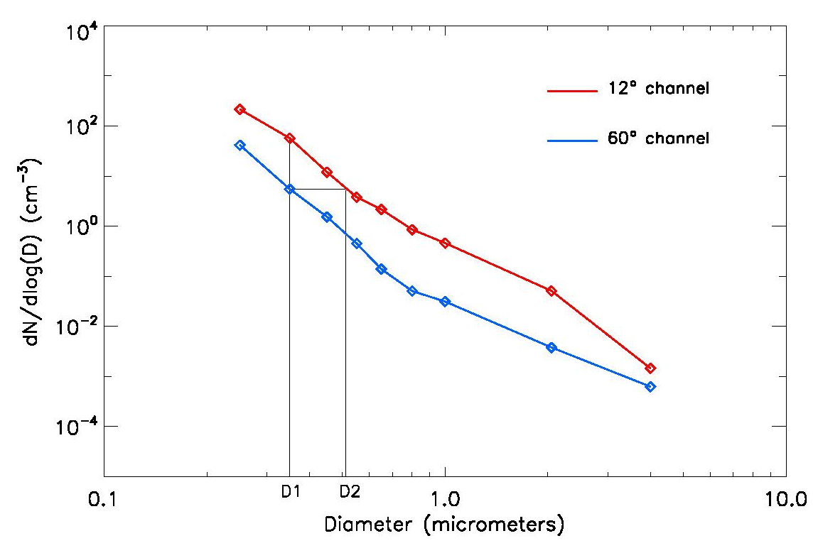
Determination of the main nature of the particles: Speciation
The 60° measurements are very sensitive to the refractive index of the particles
More absorbing are the particles, lower are the scattered flux
The 60° size distribution is often
lower than the 12° real size distribution
The ratio of the 2 size distributions
varies with the nature of the particles

Slide 8
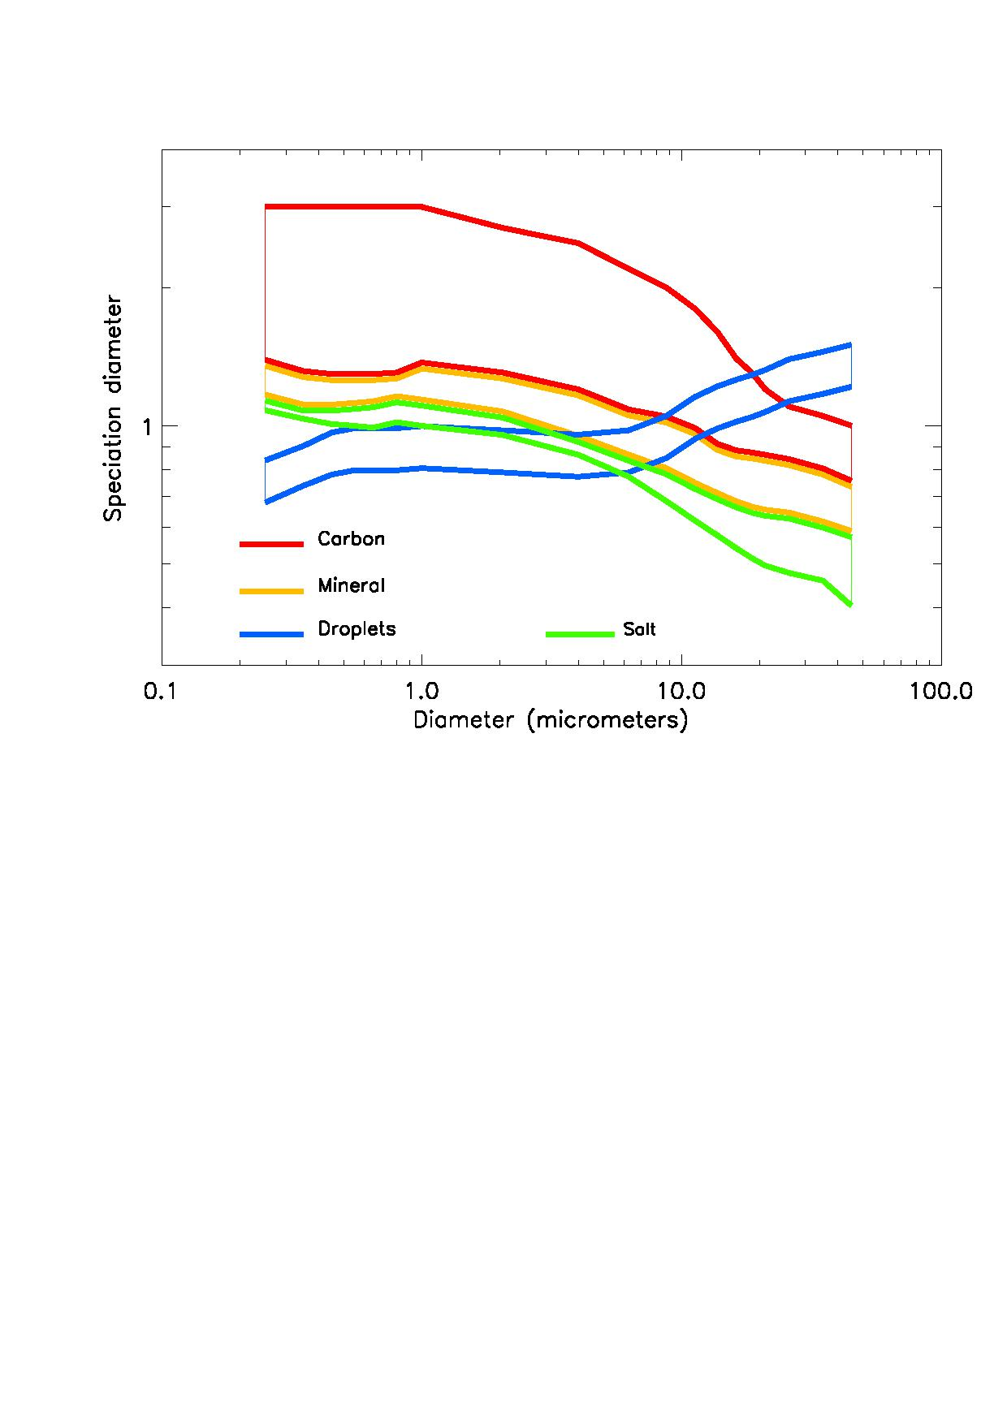
The 12°/60° ratio is compared to charts obtained in laboratory for different families of particles:
- Liquid droplets
- Minerals
- Carbons
This is an open data base and other natures
of particles can be considered (no more than
3 or 4 different natures)

Slide 9
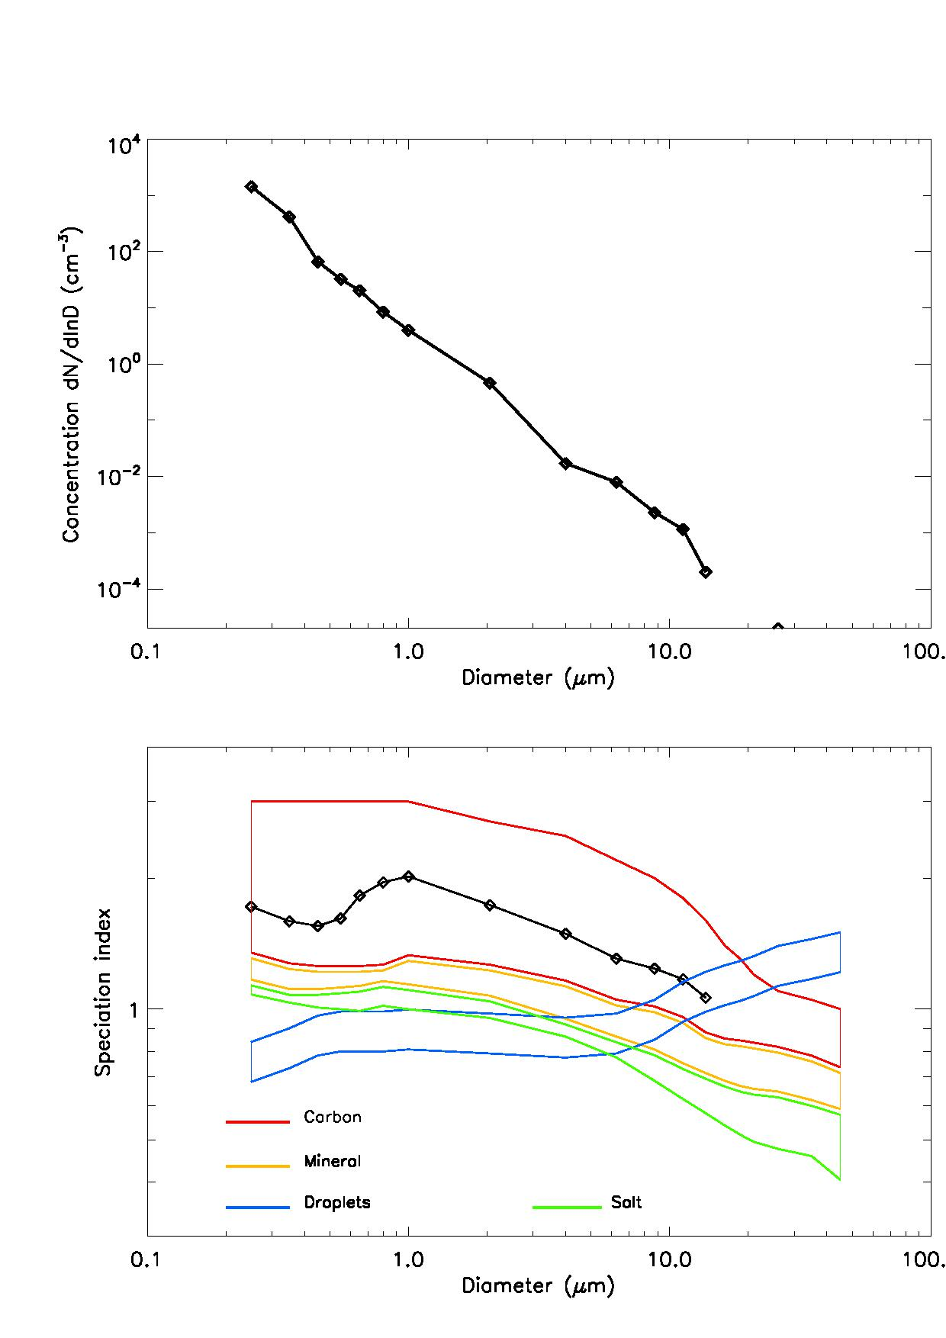
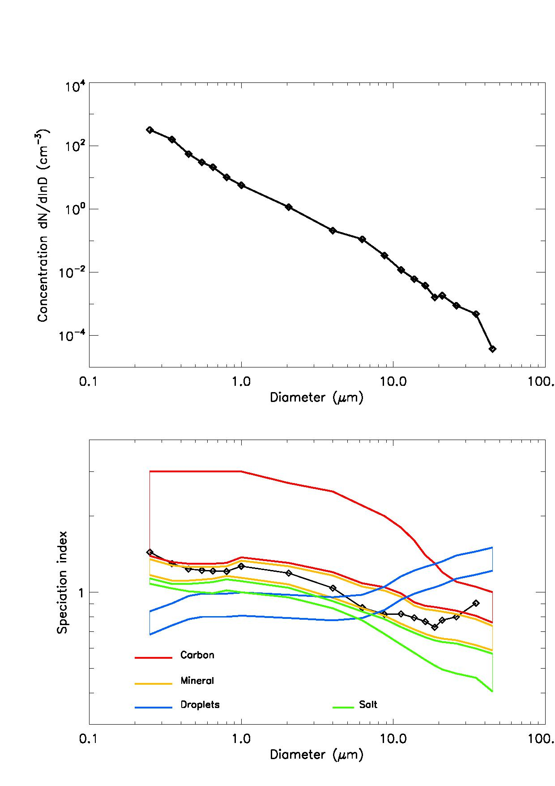
Pollution carbon particles
Saharan sand plume
Size distribution
Size distribution
speciation
speciation

Slide 10
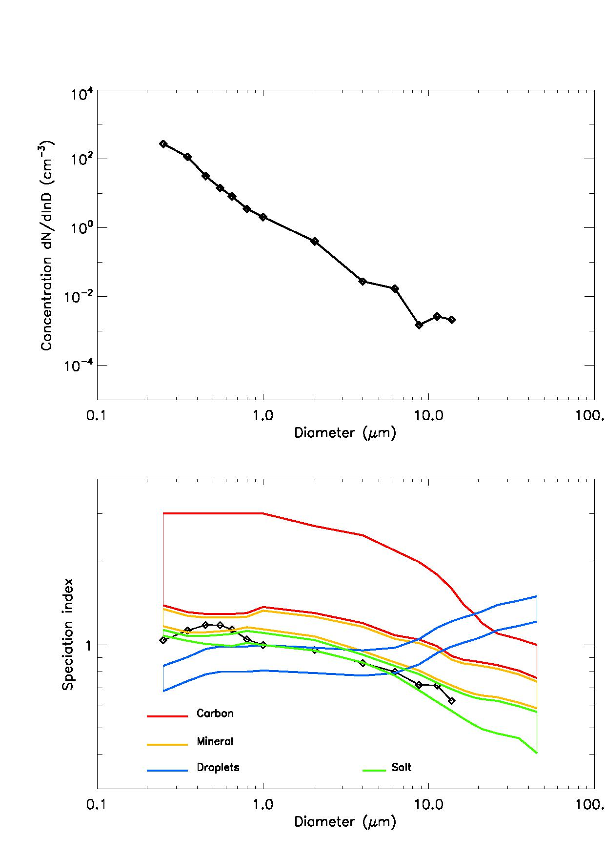
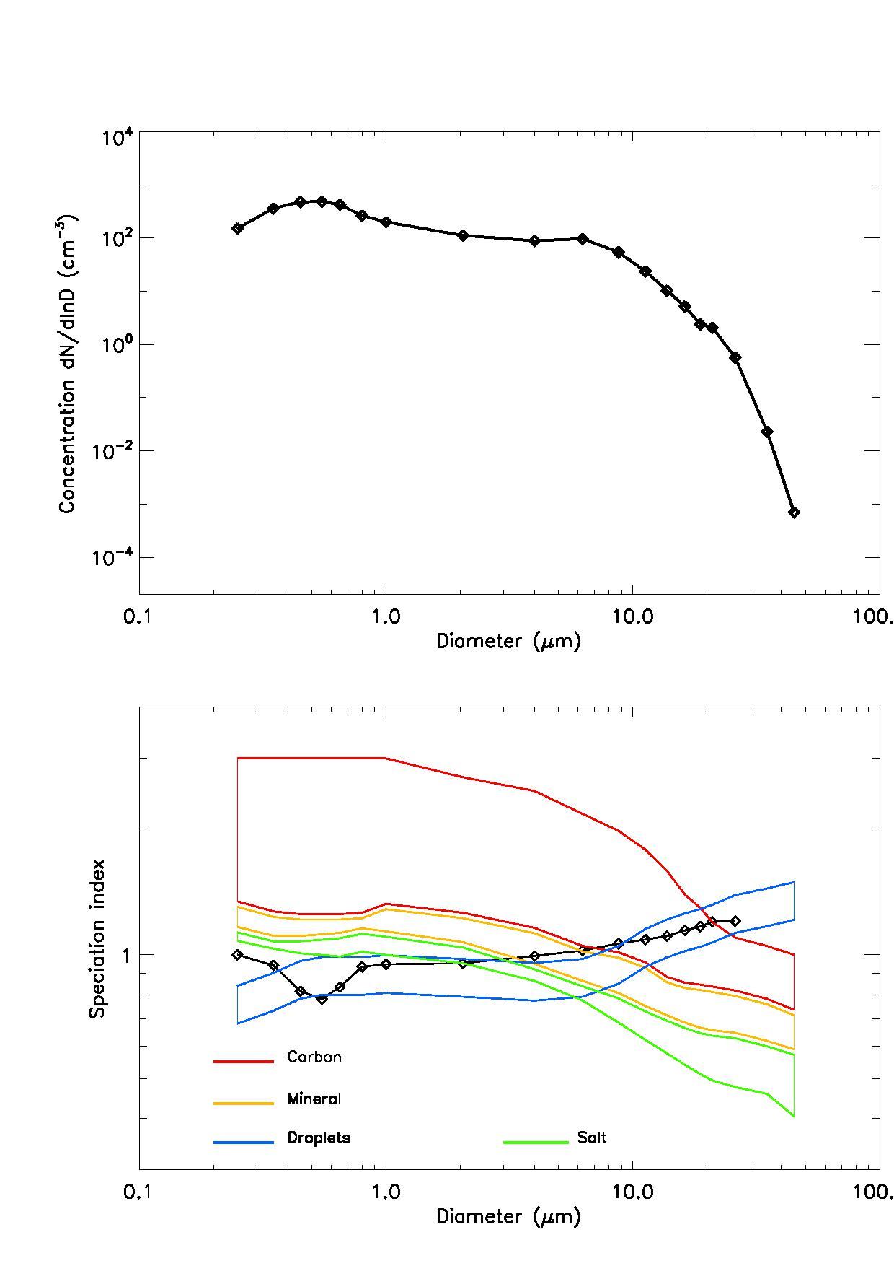
Sea salt
Inside a cloud
Size distribution
Size distribution
speciation
speciation

Slide 11
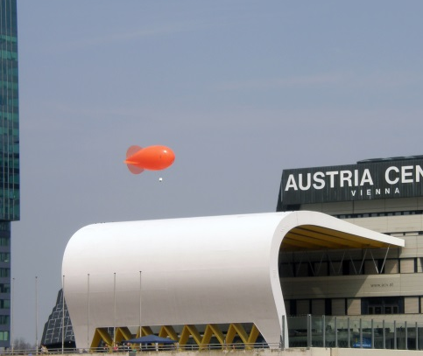
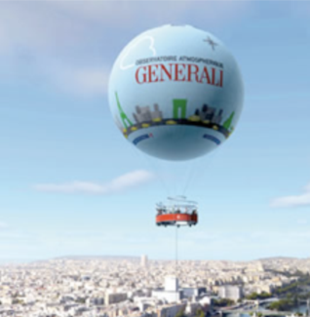
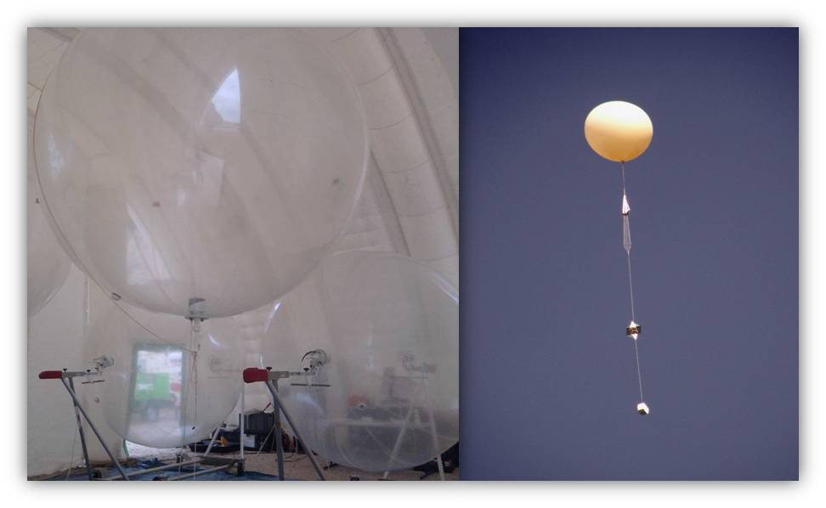
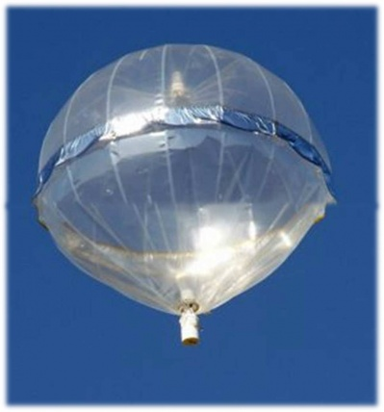
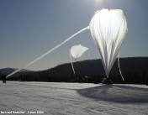
LOAC is used at ground and under all kinds of balloons:
tethered, meteo, low troposphere, stratosphere
“Modular” instrument : LOAC can work with different kinds of pump (between 1.3 and 2.7 l/mn) and with different kinds of inlets depending on the sampling conditions

Slide 12
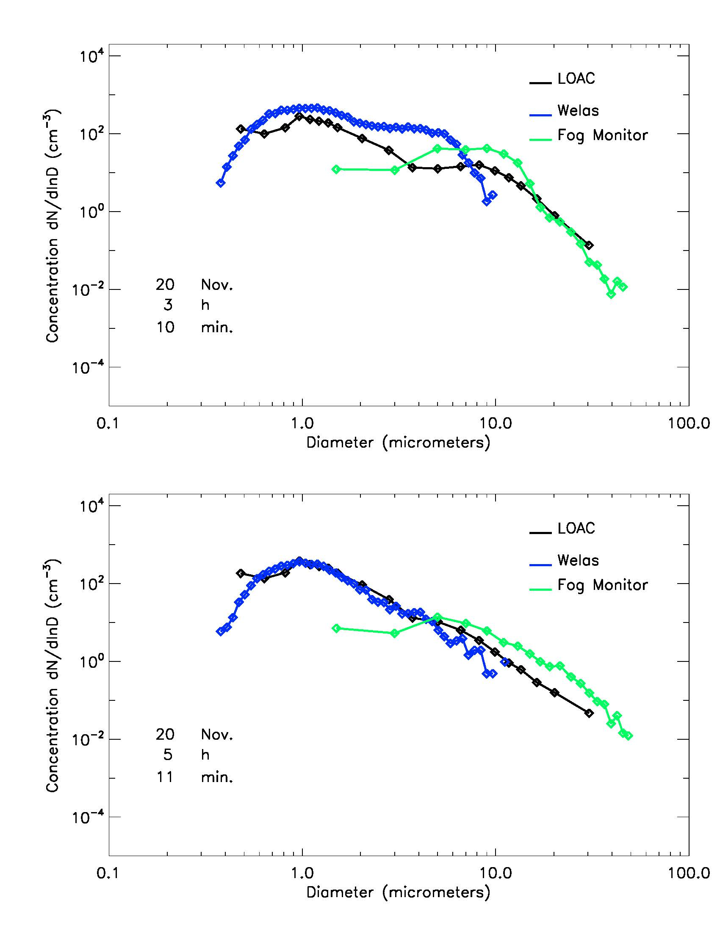
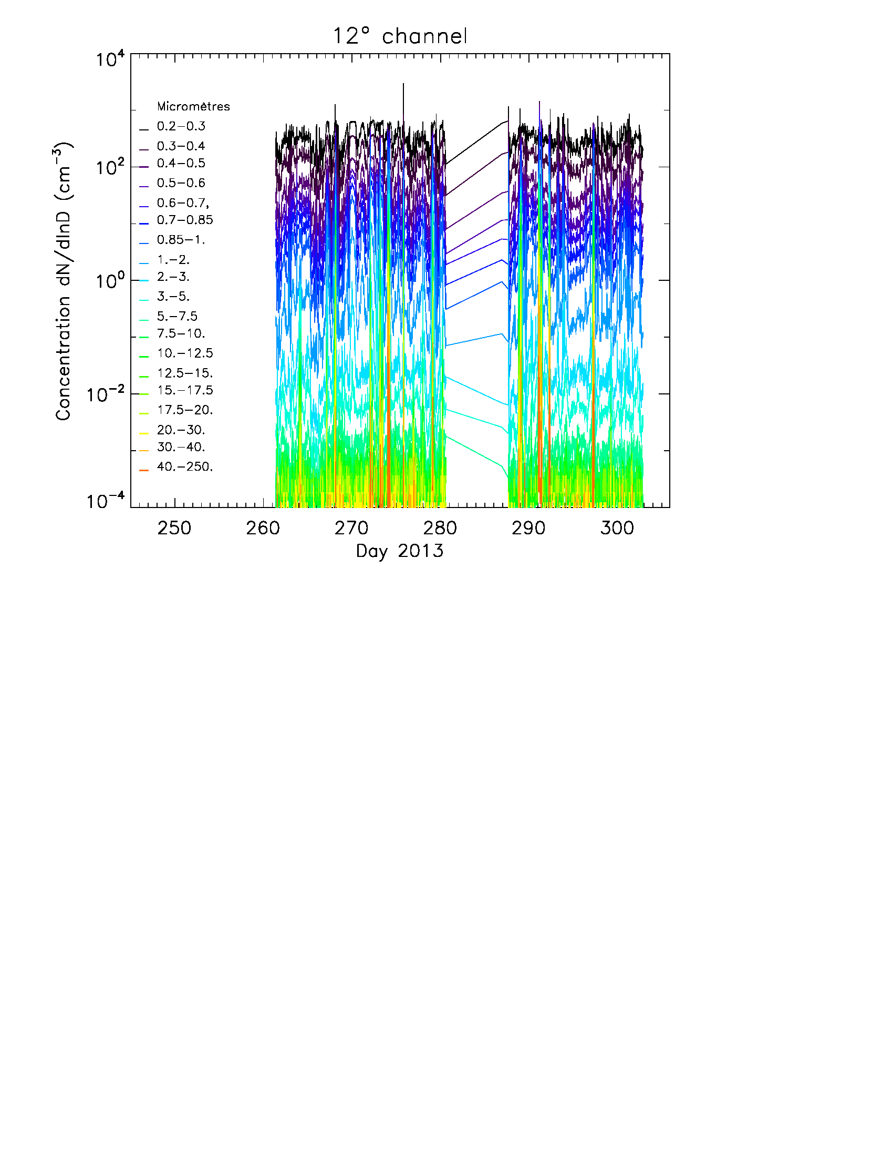
Beginning of the fog
Permanent measurements at ground in the south sunburn of Paris to study fog events
End of the fog
Welas and Fog Monitor : optical counters

Slide 13
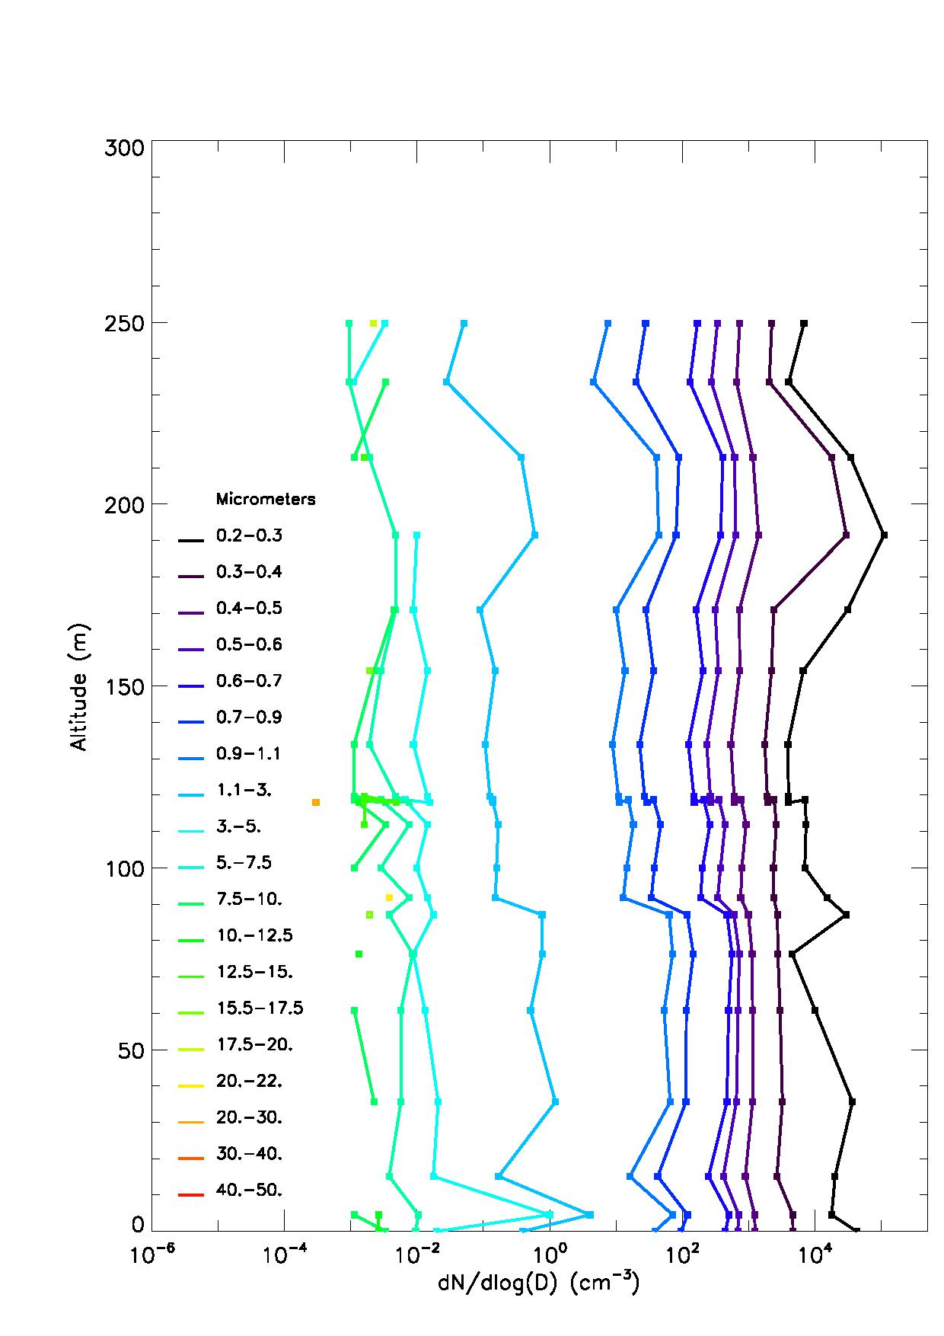
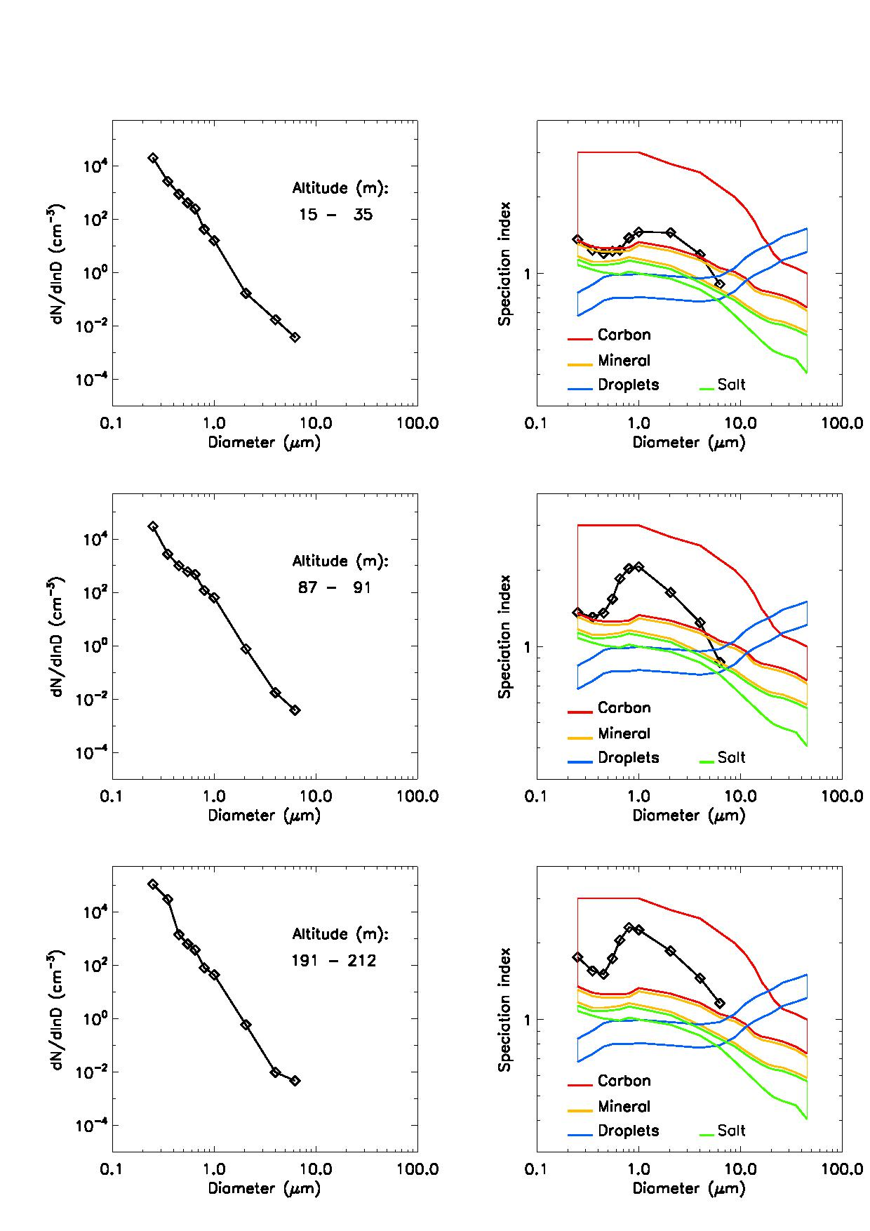
Permanent measurements on board the touristic balloon “AOG” in Paris, from ground to an altitude of 250 m
Strong pollution event on 11 December 2013 and inversion layer at an altitude of 200 m
Close to the ground, various natures
At 200m, black carbon

Slide 14
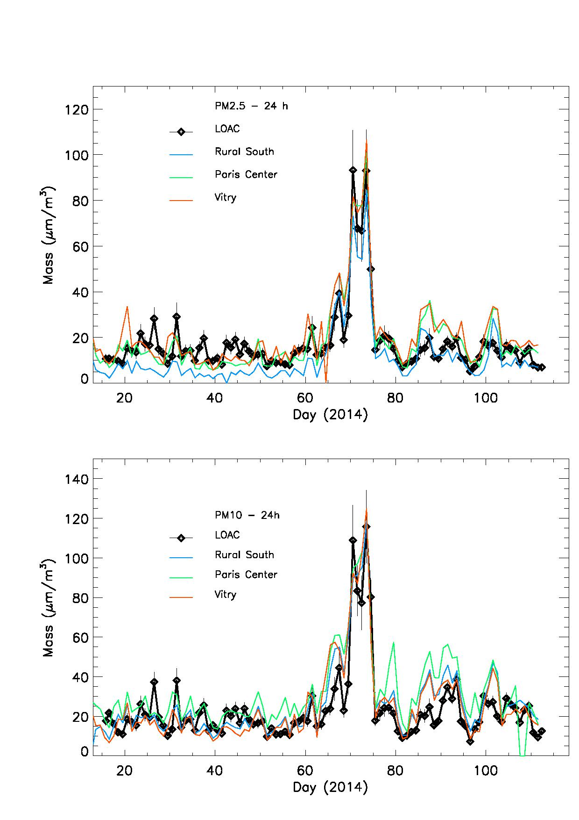
Counting measurements can be converted to PM 2.5 and PM10 mass (μg/m³)
Mean densities used from speciation results:
1.4 g/cm³ for carbon
2.2 g/cm³ for minerals and salts
0 g/cm³ for droplets
(small changes in case of humidity > 65%)
Comparison with microbalance measurements
from AirParif ambient air network
Very good agreement

Slide 15

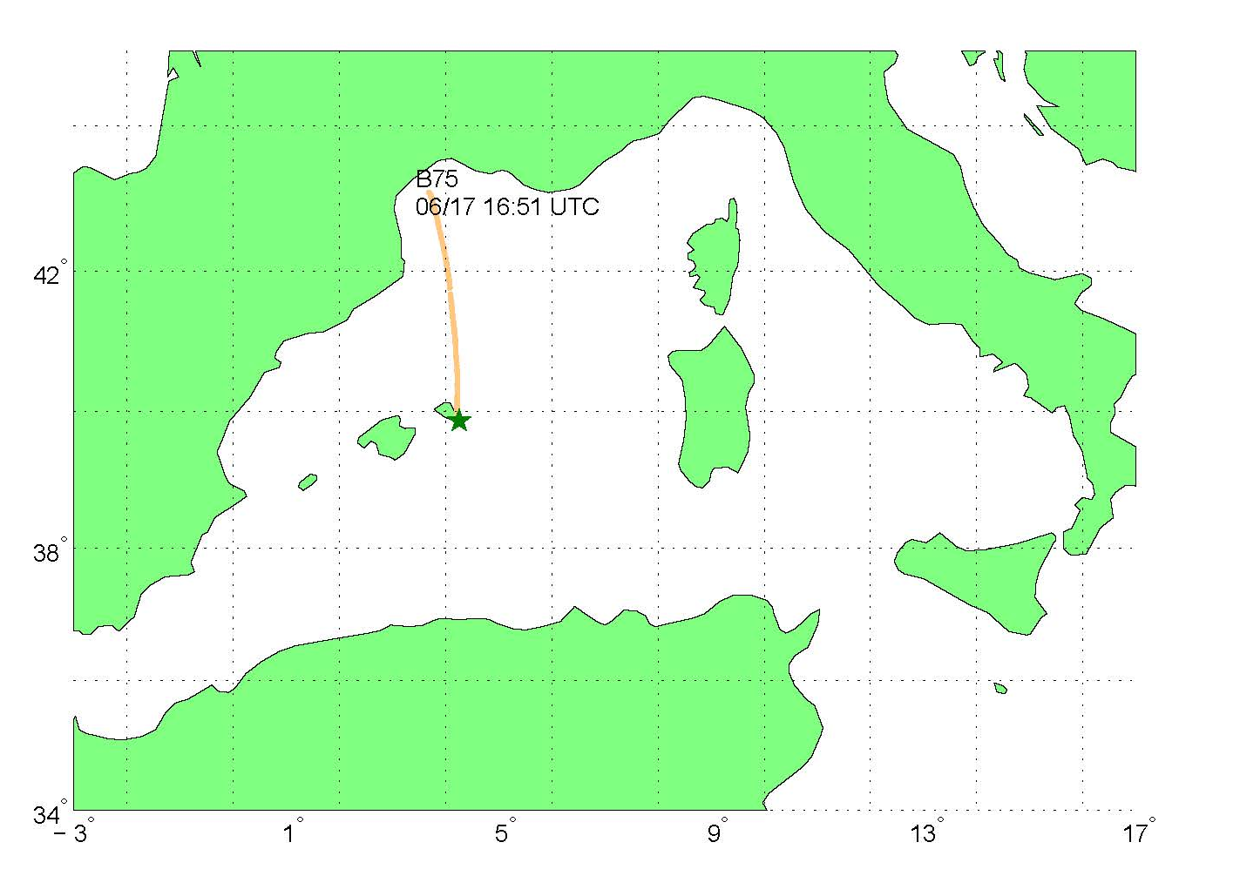
LOAC has performed 19 flight under BPCL (long duration tropospheric balloons) and BLD (Meteo balloon) during the Charmex campaign, summer 2013, above the Mediterranean Sea
BPCL trajectory on 17 June 2013, altitude of 2000 m

Slide 16
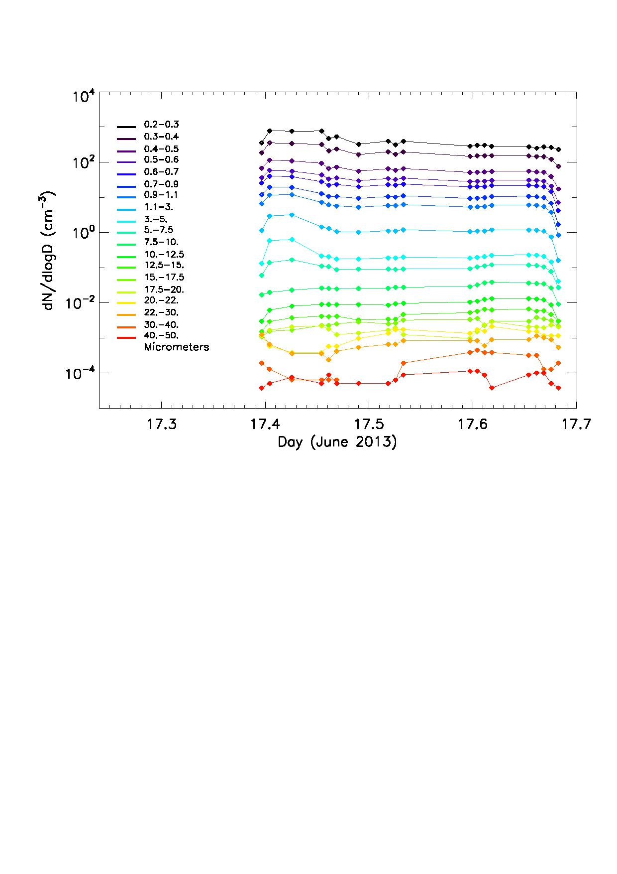
Flight inside a Saharan sand plume
Detection of large particles
Particles transported during
several days
No sedimentation
Indirect detection of strong
electro-magnetic field inside
the plume

Slide 17
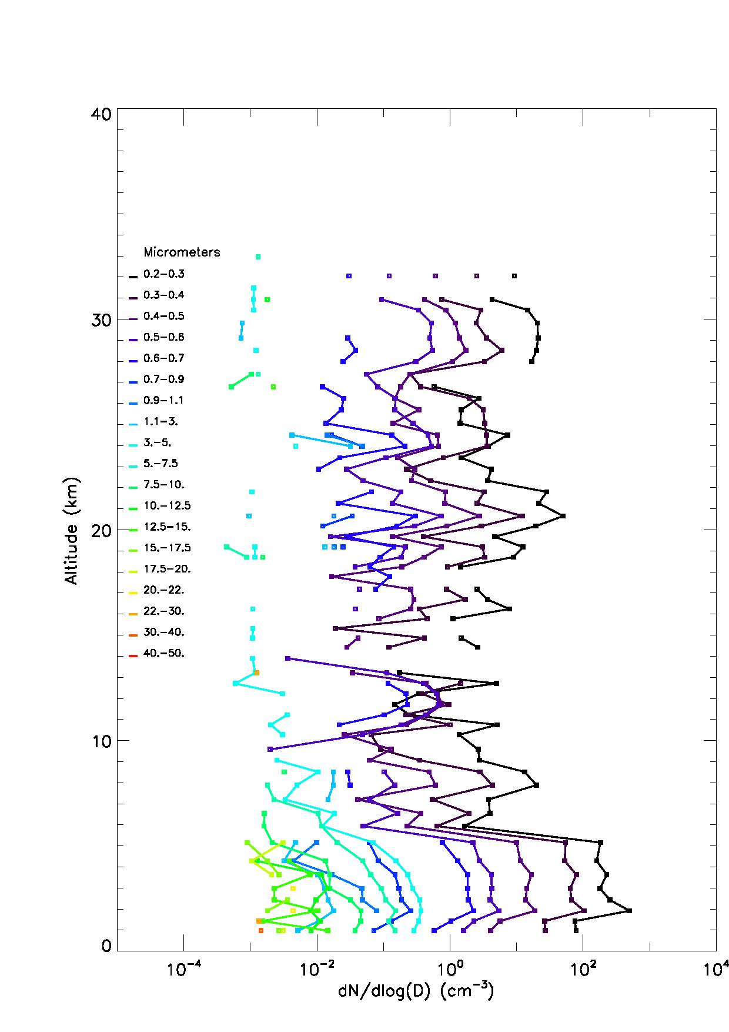
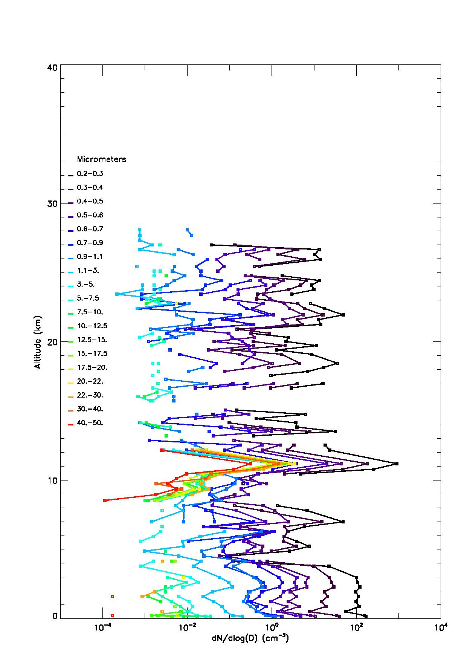
Vertical profiles of aerosol content with BLD (meteo) balloons
17 June 2013, Minorca
23 June 2014, Ury (France)
Liquid particles
Liquid droplets + soot
Sand plume
Cirrus

Slide 18

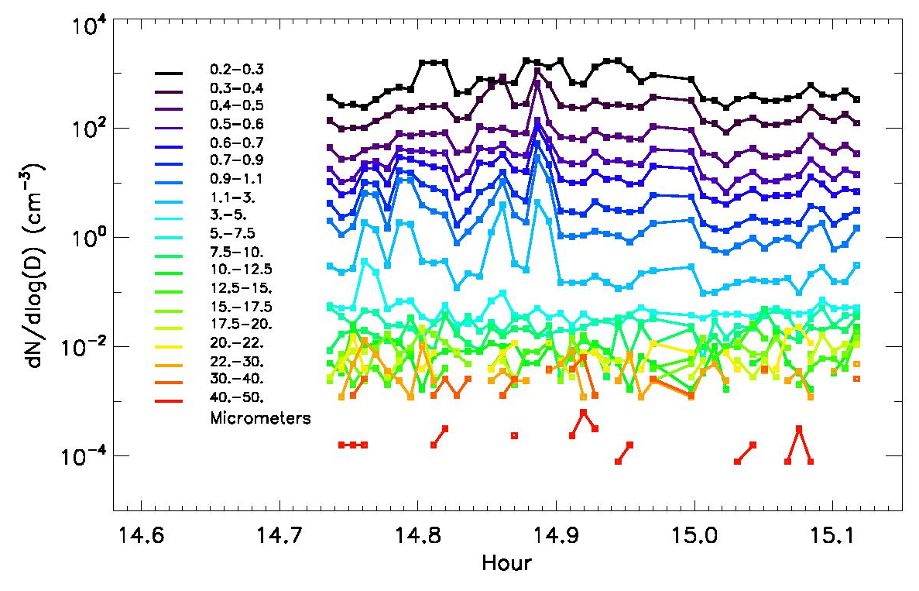
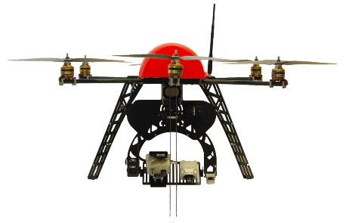
Fly on-board Unmanned Airborne Vehicles (Fly-N-Sense Society)
Environmental studies, analysis of local sources

Slide 19
CONCLUSIONS
LOAC can provide size distribution and main nature of the aerosols
Light instrument for ground and airborne measurements
Now a commercial instrument
Actual scientific campaigns:
Pollution studies in the Paris region (ground, tethered balloon)
VOLTAIRE, long-term monitoring of the stratosphere (~25 flights per year at different latitudes)

Slide 20
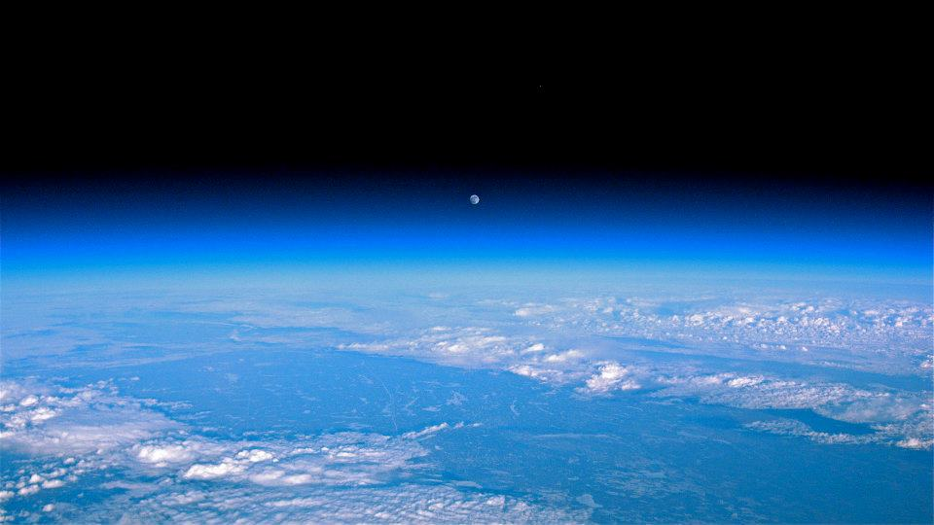
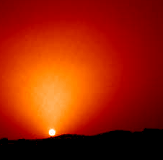
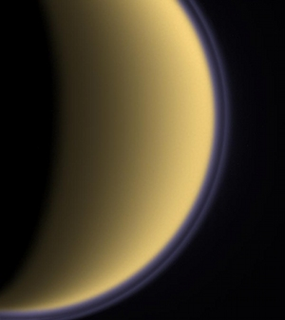
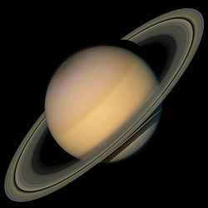
Future
Improved version of LOAC in development
STRATEOLE, long duration balloons (several months) in the lower equatorial stratosphere (coordinated by LMD-CNRS)
LOAC for space application (CNES) : Studies of planetary atmospheres
Earth
Mars
Titan
Saturn

Slide 21
Contact for science application: jbrenard@cnrs-orleans.fr
LOAC is commercialized by the MeteoModem company: http://www.meteomodem.com
LOAC on board Unmanned Airborne Vehicles is commercialized by the Fly-N-Sense company : http://www.fly-n-sense.com/

